Slide 1
Activity 2: FOURIER TRANSFORM MODEL OF IMAGE FORMATION PART 1
Genesis Vertudez – 202003099
App Physics 157 - Computational Analysis and Modeling in Physics
Submitted to Dr. Maricor Soriano; Mx. Rene Principe Jr.

Slide 2
OBJECTIVES
Use Fourier transform to manipulate images
Convolve images with patterns to apply it to them
Convolve images with filters to improve them
Use Fourier transform to locate certain patterns in images

Slide 3

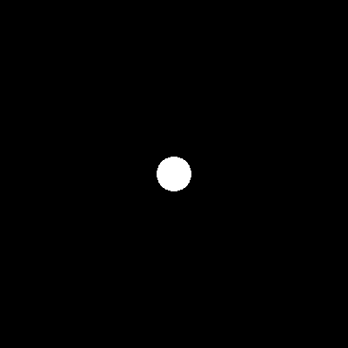


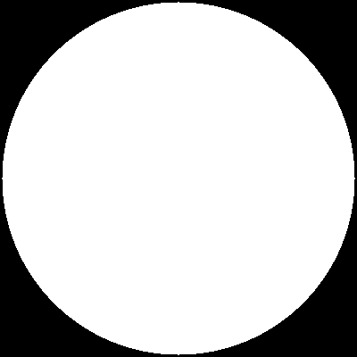


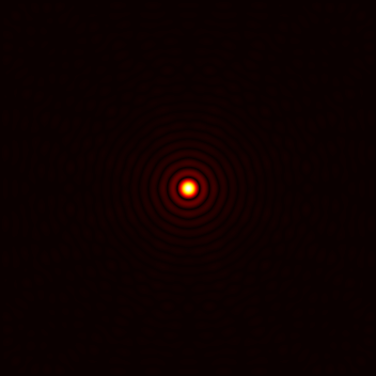
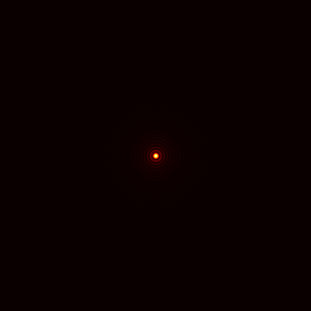
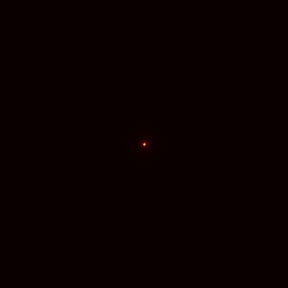
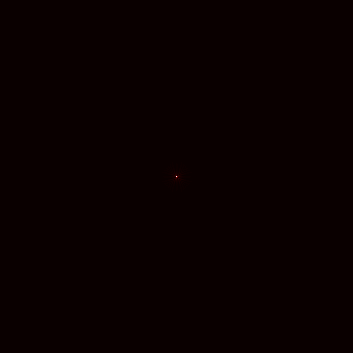
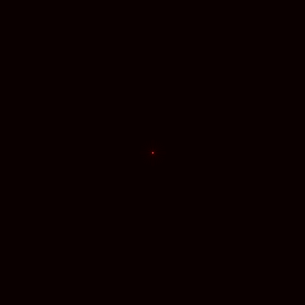
RESULTS

Slide 4
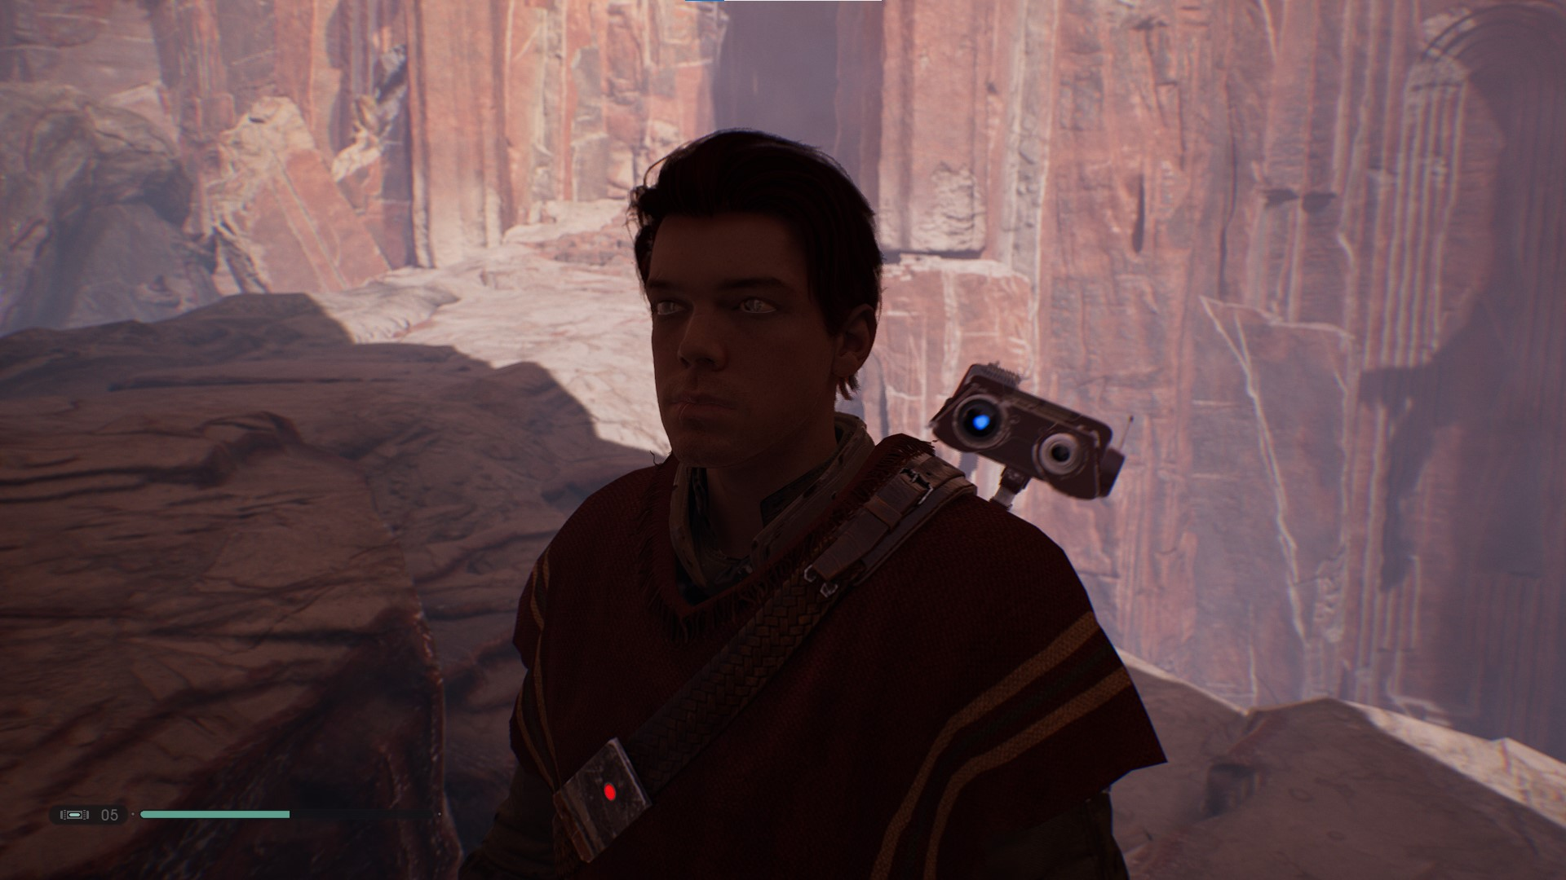
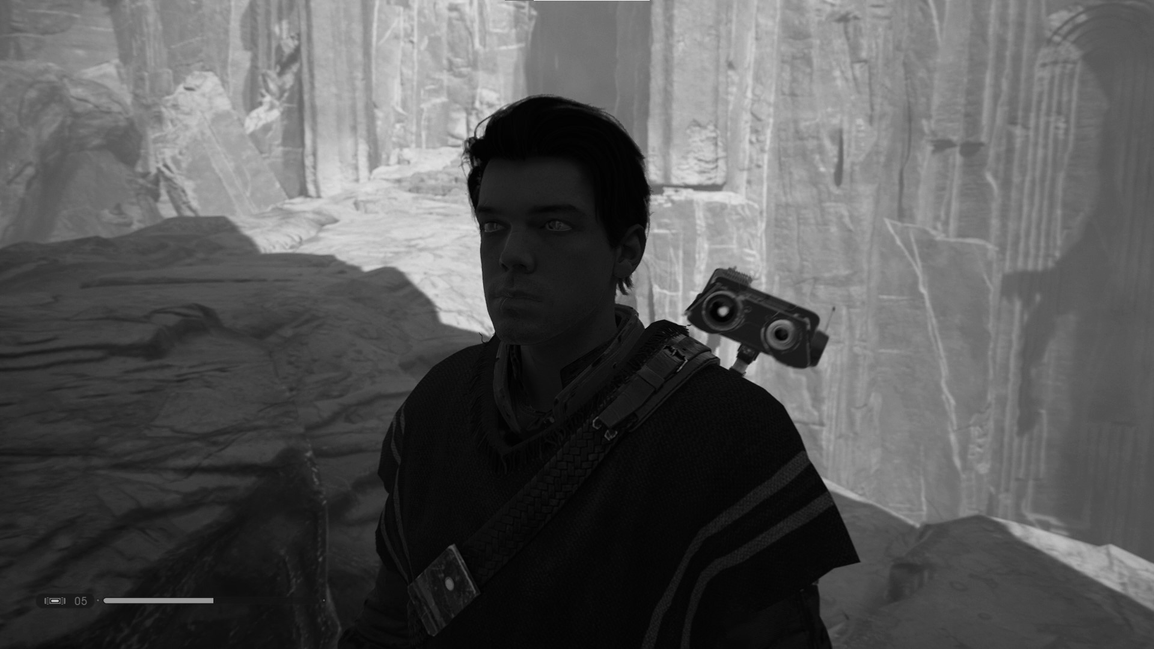
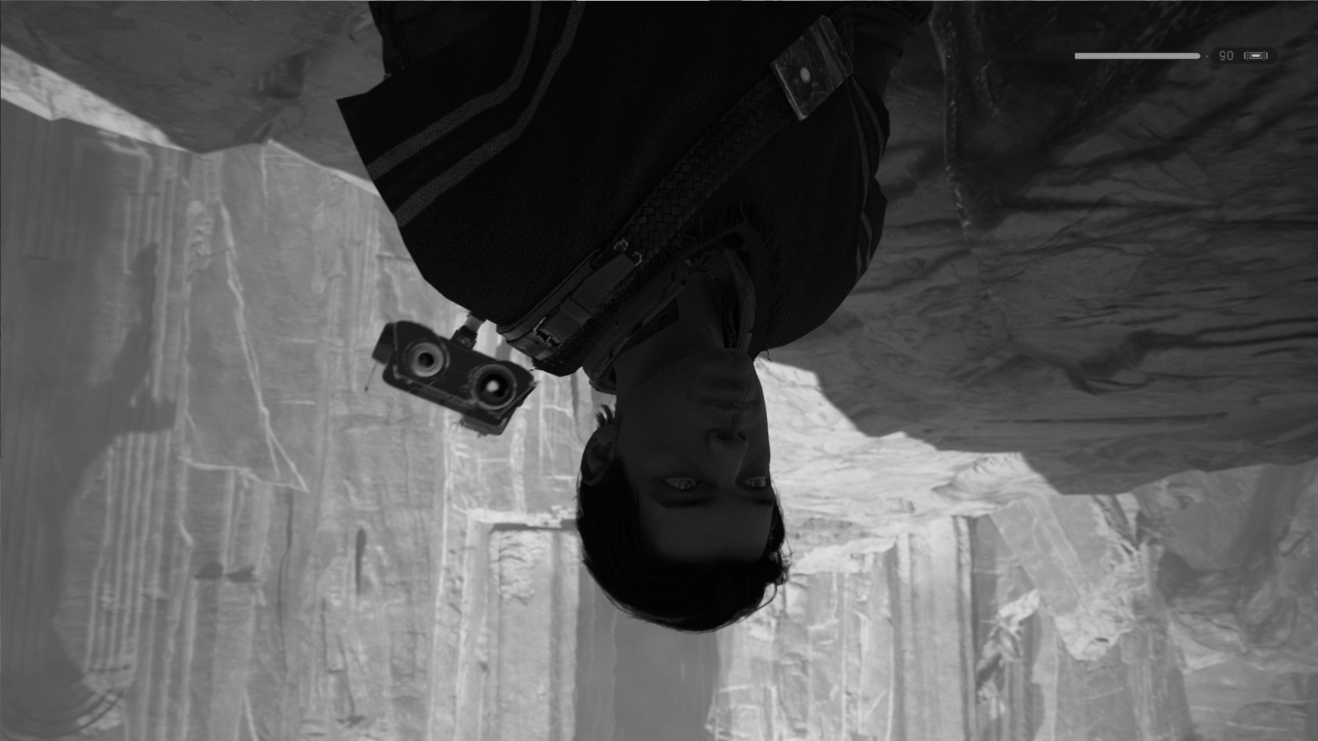

RESULTS

Slide 5







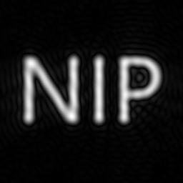
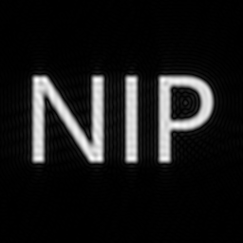



RESULTS

Slide 6
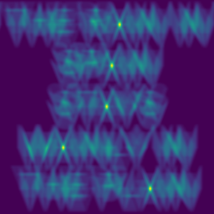
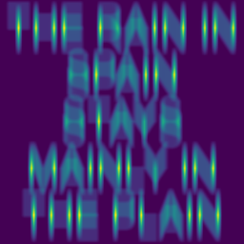
RESULTS

Slide 7
ANALYSIS

Slide 8
REFLECTION
This activity was straightforward so I was able to follow it easily.
It is cool that the pixels can act as Dirac delta functions such that it is copied to another image when convolved.
I managed to do it on time this time.
I give myself an 8/10.

